Slide 1
Security Practices in Software Development: Mitigating Risks and Ensuring Compliance

Slide 2
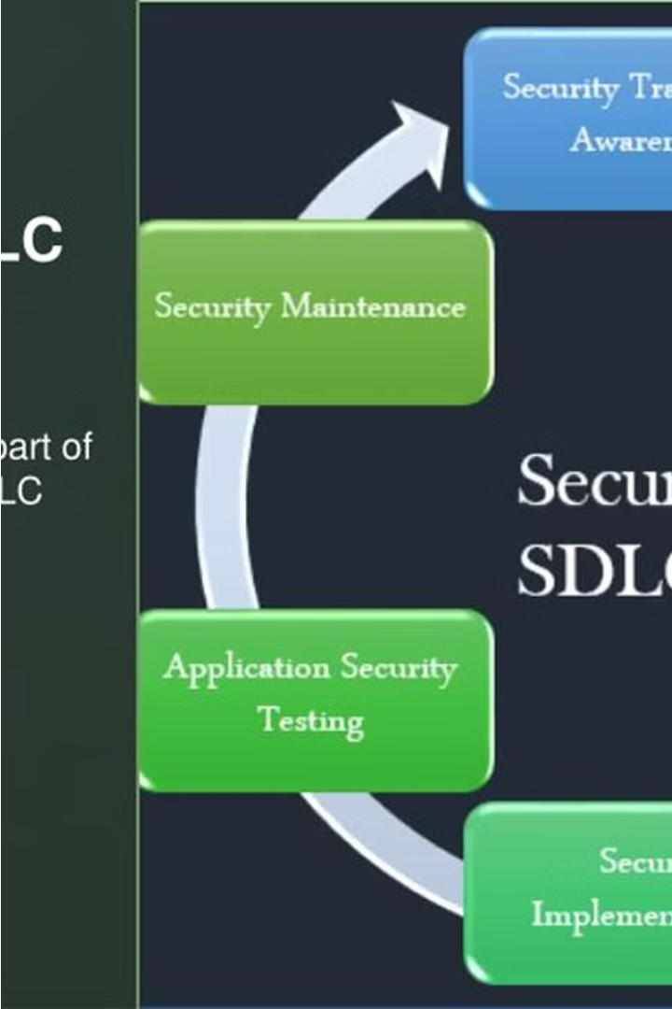

Introduction to Security in Software
Development
To Mitigate Risks: Secure coding practices, robust authentication, encryption, continuous testing, incident response planning, and compliance adherence
To Ensure Compliance: Adhering to relevant regulations, standards, and industry best practices to ensure legal and regulatory compliance.

Slide 3

The Importance of Security in Software Development:
1. Protecting Sensitive Data
2. Preventing Cyber Threats
3. Maintaining Trust and Reputation
4. Compliance with Regulations
5. Financial Loss Mitigation
6. Operational Continuity
7. Intellectual Property Protection
8. Customer Confidence

Slide 4
Implications of Data Breaches and Cyber Threats:
1. Financial Losses
2. Compromised Personal Information
3. Reputational Damage
4. Legal and Regulatory Consequences
5. Operational Disruption
6. Intellectual Property Theft
7. National Security Risks
8. Loss of Trust in Digital Technologies

Slide 5

Secure Coding Practices
Implementing secure coding practices is crucial to mitigate software vulnerabilities and protect against cyber threats. This includes techniques like input validation, secure error handling, and the use of cryptography to safeguard sensitive data.
Developers should adhere to secure coding guidelines, leverage automated security testing tools, and participate in security-focused code reviews to ensure the highest levels of application security.

Slide 6




Vulnerability Assessment Techniques
Static Code Analysis
Automated tools that scan source code to identify security vulnerabilities early in the development process.
Dynamic Testing
Simulating real-world attacks to uncover vulnerabilities in running applications and reveal exploitable weaknesses.
Penetration Testing
Ethical hacking exercises to systematically probe for and exploit security gaps in the software and infrastructure.

Slide 7
Threat Modeling Strategies
Identify Threats
1
Analyze potential attack vectors and vulnerabilities.
2
Assess Risks
Evaluate the likelihood and impact of identified threats.
Prioritize Mitigation
3
Focus efforts on high-risk threats with effective countermeasures.
4
Implement Controls
Deploy security measures to address prioritized threats.
Effective threat modeling is a crucial step in securing software applications. By systematically identifying potential threats, assessing their risks, and implementing targeted countermeasures, development teams can proactively mitigate security vulnerabilities and strengthen the overall resilience of their systems.

Slide 8



Regulatory Compliance Requirements (GDPR, HIPAA)
GDPR
HIPAA
Compliance
The General Data Protection Regulation (GDPR) sets strict standards for data privacy and security, mandating robust controls for personal data handling.
The Health Insurance Portability and Accountability Act (HIPAA) regulates the protection of sensitive patient health information in the healthcare industry.
Adhering to these regulations is critical to avoid hefty fines and safeguard the privacy and trust of customers and patients.

Slide 9
7Key Points of GDPR :
Individual consent is required before any data can be collected or processed.
Individuals will be notified promptly if their data is breached or interfered with.
All data will be made and remain anonymous.
International data transfers will be managed more securely.
Companies are required to appoint a data protection officer (DPO) to protect client data.
Any company that provides a service or product to residents of the EU is required to comply with the GDPR.
Companies that do not comply with the GDPR regulations will be subject to hefty fines.

Slide 10

Privacy Requirements Under
HIPAA :
Patient identity and social security number
Patient diagnosis and condition
Record of care or treatment provided to a patient
Payment information that could potentially be used to identify the patient

Slide 11
Compliance Impact on Software Development Practices
Stricter Coding Standards
Robust Testing
Heightened Documentation
Secure Development Lifecycle
Compliance mandates extensive testing for vulnerabilities and security breaches, including penetration testing, static code analysis, and dynamic application security testing.
Compliance requirements demand more rigorous secure coding practices, such as input validation, error handling, and encryption to protect sensitive data.
Detailed documentation on security measures, risk assessments, and compliance adherence is crucial to demonstrate regulatory compliance during audits.
Compliance forces developers to integrate security considerations throughout the entire software development lifecycle, from design to deployment.

Slide 12
Recommendations for improved security in software development
Start with a secure design
follow secure coding practices
use secure libraries and frameworks
Implementation of proper authentication
Encrypt sensitive data
Regularly update and patch
Conduct security testing
Monitor security incidents
Educate developers and users

Slide 13

Conclusion and Key Takeaways
Security practices in software development
Need of security practices in software development
It’s importance in software development
Threats and their Effects

Slide 14

Thank You
Thank you for your time and attention. We hope this presentation has provided valuable insights into security best practices for software development. Please feel free to reach out if you have any further questions or would like to discuss this topic in more detail.

